Slide 1

AquaInsight
Data-Driven Strategies for Potable Water Assurance
TEAM MEMBERS:
Shreyanshi Mukesh(e23mcag0014)
Aakriti Jain(e23mcag0131)
Nitesh Kumar(e23mcag0061)

Slide 2

INTRODUCTION
In order to ensure public health and sustain life, access a pure drinking water is very essential. Measuring water quality is very essential since contaminated water can cause a variety of medical problem. The goal of this research is to use machine and deep learning approach to address the problem of estimating potability and evaluating the purity of water.
There are many water quality indicators, such as pH, hardness, solids, chloramines, organic carbon, these compounds are included in the dataset used in this study. These indicators are frequently used in evaluations of water quality and serve as crucial indicators of water safety.

Slide 3

PROBLEM STATEMENT
The "Water Quality and Potability" project addresses the critical issue of ensuring safe drinking water for communities. With a focus on evaluating water quality parameters, this project employs machine learning models to predict the potability of water based on a diverse set of chemical and physical attributes.

Slide 4
OBJECTIVES:
1
Improved Water Quality Monitoring
2
Regulatory Compliance
3
Industry Collaboration
Establishing frameworks to ensure compliance with relevant regulations and standards.
Promoting collaboration among stakeholders to create a more robust table water assurance system.
Developing strategies to enhance water quality monitoring and ensure safe consumption.

Slide 5
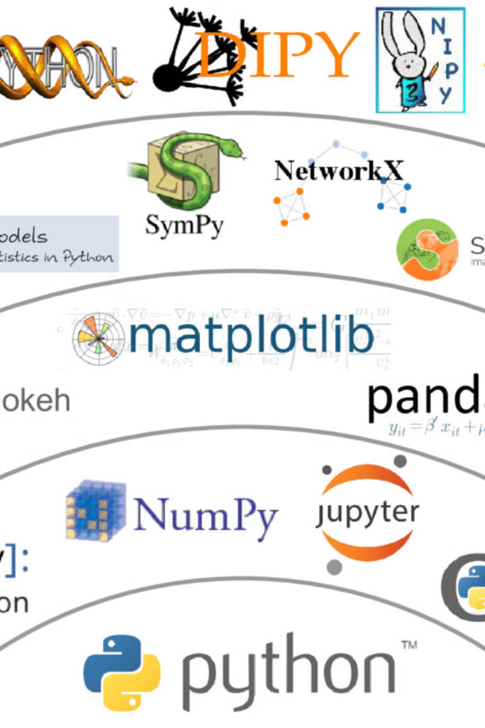
LIBRARIES USED:
1) NUMPY
2)PANDAS
3)MATPLOT
4)SEABORN
5)SKLEARN
6)PYLAB
7)SIMPLEIMPUTER
8)TRAIN_TEST_SPLIT
9)SCIPY

Slide 6
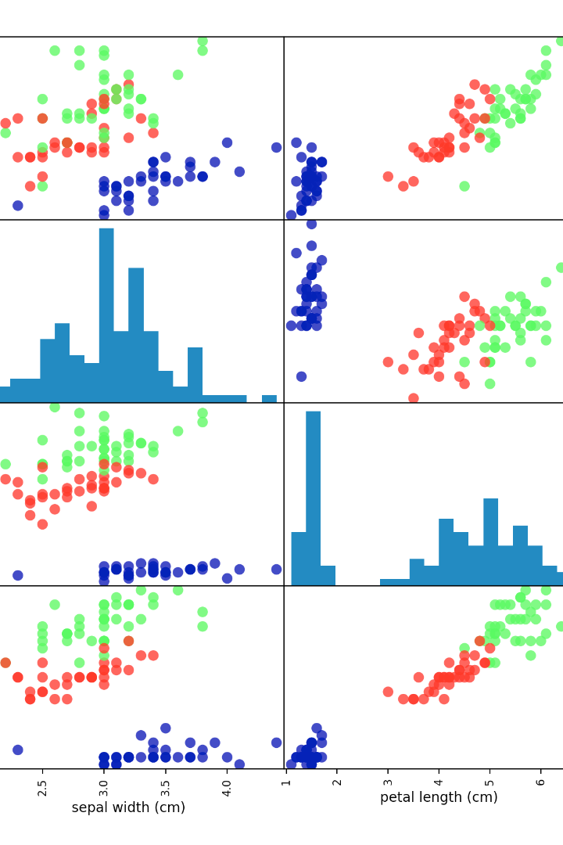
GRAPH USED
1)PAIR PLOT
2)HISTOGRAM
3)QUANTILE QUANTILE PLOT
4)COUNT PLOT
5)Z SCORE

Slide 7
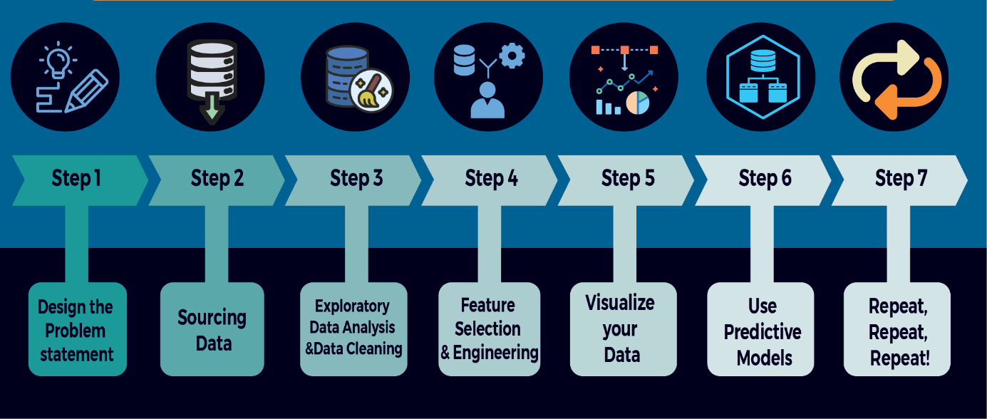
METHEDOLOGY

Slide 8
Results and Findings
1
Enhanced Compliance
Our data-driven strategies have led to a significant increase in regulatory compliance across the table water industry.
2
Improved Quality Control
Through advanced analysis, we have identified key quality control measures that have resulted in enhanced water quality.
3
Increased Consumer Confidence
Consumer confidence in table water products has risen, thanks to our data-driven approach and transparent reporting.

Slide 9
Conclusion
1
A New Era in Table Water Assurance
2
Continued Innovation
3
Join the Aquainsight Movement
Aquainsight's data-driven strategies have paved the way for a more reliable and efficient table water assurance system.
We remain committed to ongoing research and innovation to further improve water quality and consumer safety.
Partner with us to shape the future of table water assurance through data-driven strategies and collaboration.

